Slide 1

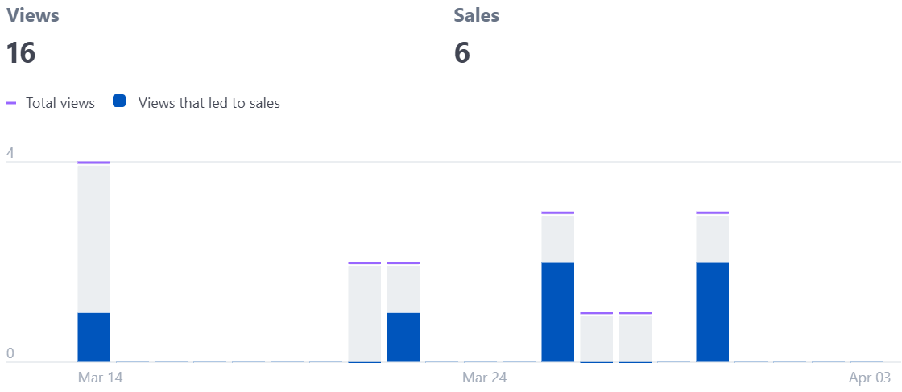
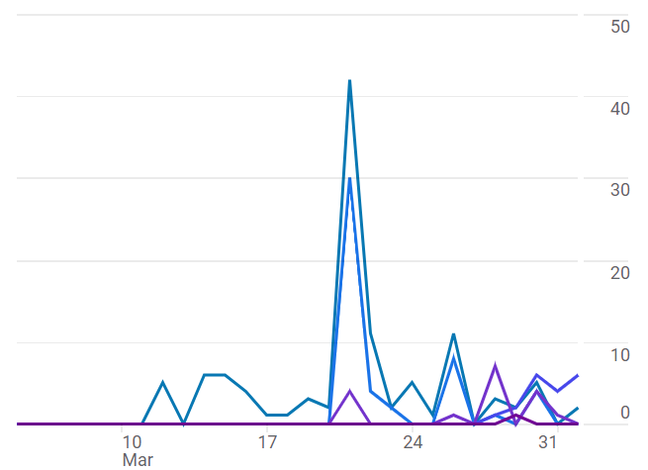
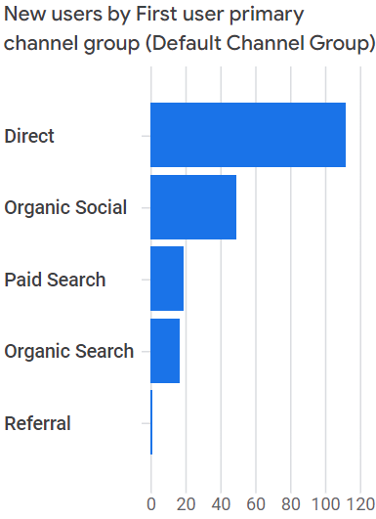
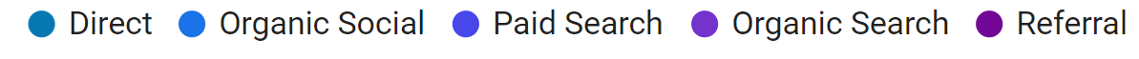
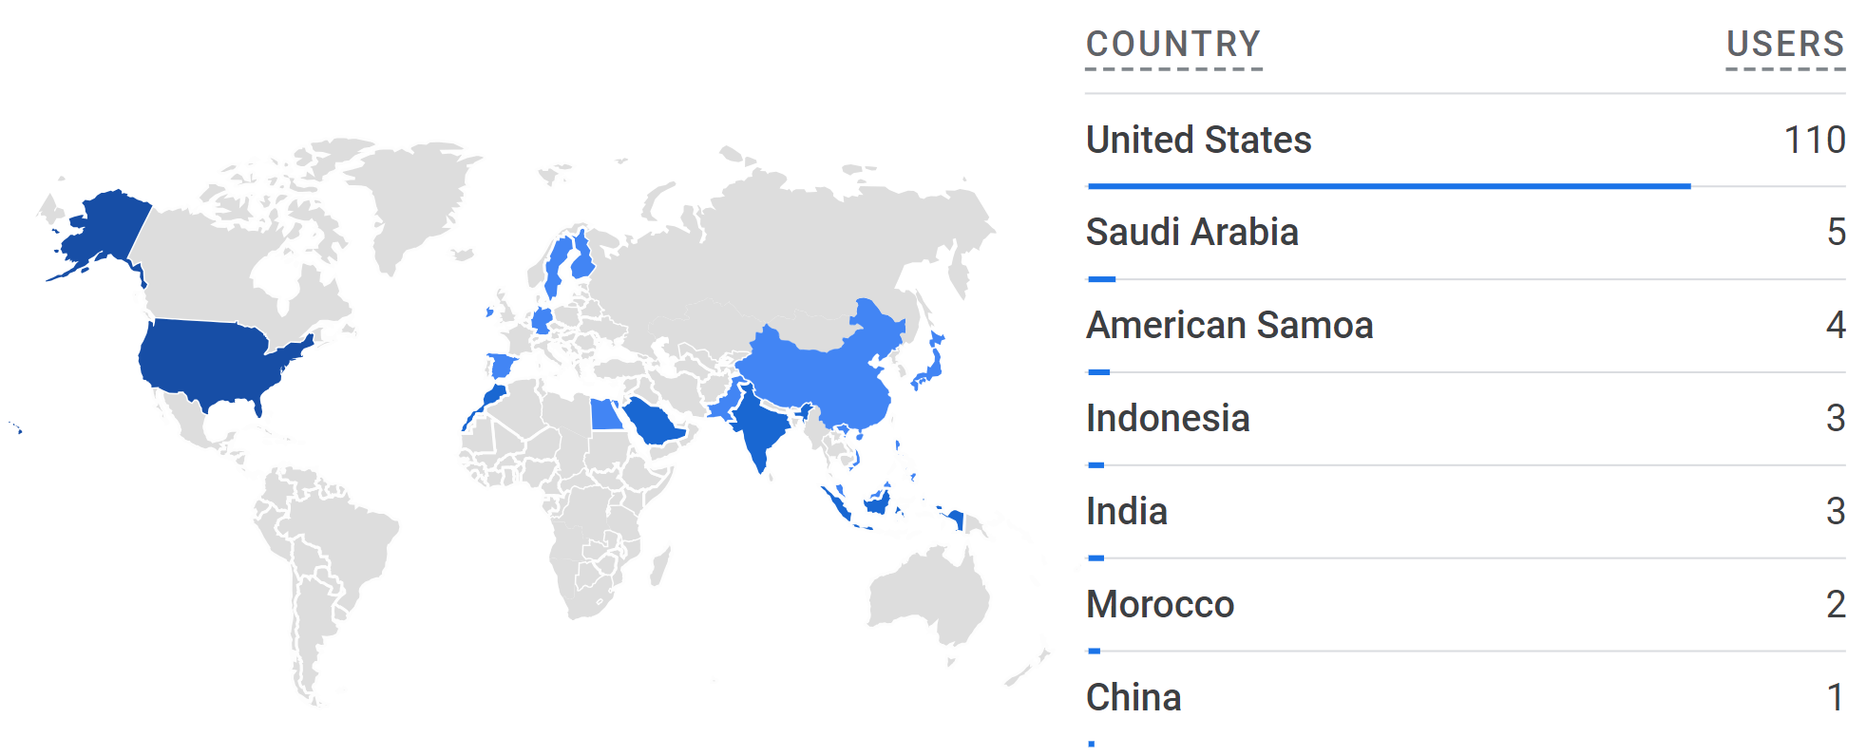
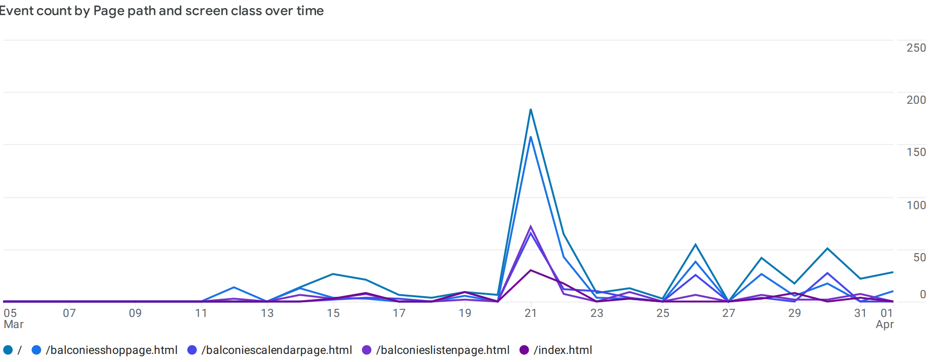
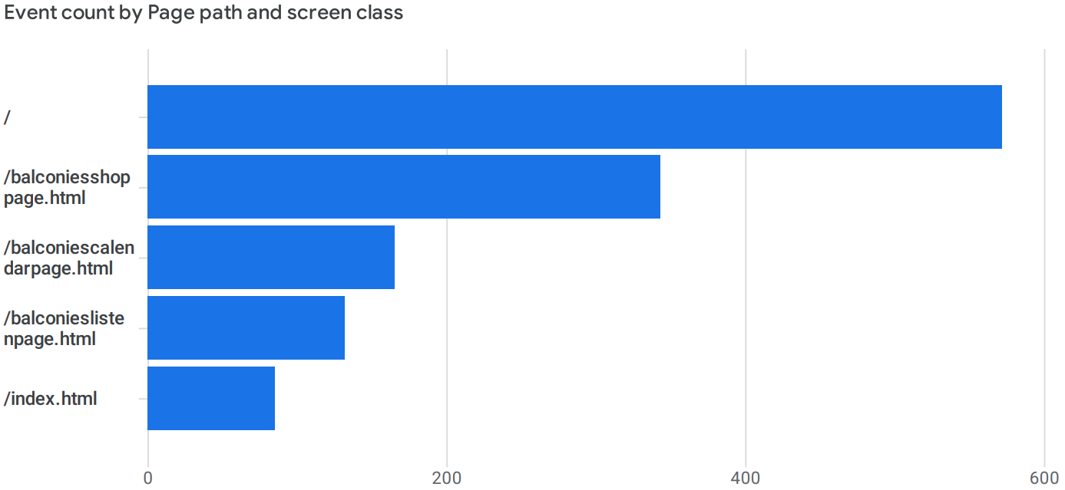

Online Advertising in 2024
Is Google Ad Services worth it?
Coley Brown
ABSTRACT
STRIPE VIEWS AND SALES OVER TIME
USER TRAFFIC BY CHANNEL
This project focuses on creating a dedicated website for a college band, employing various strategies including live event marketing, word-of-mouth and social media advertising as well as a Google Ad campaign to enhance traffic and online presence. The objective is to measure and improve website traffic through targeted promotions and compare the effectiveness of each of these efforts. By leveraging online platforms and analytical tools, the project aims to establish a cohesive online presence for the band, showcasing its music, merchandise, and events while understanding key demographics and interests of a target audience.
Total Views
Views that led to sales
INTRODUCTION
In the digital age, creating an online presence as a business or artist is imperative
Sellers are forced to use platforms like eBay or Amazon, or rely on Google to promote their products
What is the most effective way for an independent business to reach customers?
Used HTML and CSS formatting, Stripe and Google tags for payment and analysis, NameCheap for a domain the-balconies.com, and Git version control
Views of the Stripe payment link, not of the entire site
First views after mention at live show on March 12, word-of-mouth
Began picking up around March 21, first Instagram post
Continued usage after March 21 makes it unclear if Google Ad campaign added value
Aside from the initial test purchase, projected trend for future sales is upward
Prolonged exposure via Google Ad campaign could create more opportunities with continued investment
From Stripe Payment Analytics
New Users by Primary Channel Group
Direct
Organic Social
Paid Search
Organic Search
USER TRAFFIC BY COUNTRY
Referral
TRAFFIC OVER TIME BY PAGE
First Peak, Mar 12- after first mention of the site at live show
Highest Peak, Mar 21- after first social media post about website
Most Traffic Over Time- Direct Search
Organic Search- slightly higher since Google Ad campaign, still the lowest traffic over time
Paid Search increase lines up with start of Google Ad campaign
From Google Analytics
Event Count over Time by Page
easily modifiable
Shop Page
Calendar Page
Listen Page
Home Page
CONCLUSION
Largest jump in user engagement was after Instagram post
Unclear if Google Ad campaign had an effect on sales, but definitely had an effect on page views
Google Ad campaign likely would have performed better with more than a $50 budget per week
Social media marketing is free
Google Analytics is also free
ACKNOWLEDGMENTS
Around 90% of users come from the US
Many of the remaining ~10% are likely from the US, however using Virtual Private Networks
From Google Analytics
https://github.com/c0leybr0wn/475ProjRepo
Home page has by far the most views and clicks, with second highest being the shop page
Pages /index.html and / are both the home page
From Google Analytics
This project was made possible thanks to the Furman Computer Science Department and Dr. Sultan. Also thanks to my bandmates for allowing me to use their likeness on the site.

